Slide 1


CVI620/ DPS920 Introduction to Computer Vision Performance Evaluation
Seneca College
Vida Movahedi

Slide 2
Overview
Dataset Splits
Overfitting vs Underfitting
Performance Evaluation
Classification
Regression
ROI-based

Slide 3
Training / Test Sets
Learning from training data
Choose methods and models
Set parameters
Testing the trained method(s)
Compare with competition
Unknown until evaluation
Training Set
Test Set

Slide 4
Low Performance
Measuring Performance
Error
Possible reasons for low performance?
Not enough data, or useful data (not separable when classifying?)
Not a suitable learning algorithm
Not enough computing to run the algorithm longer (need for more iterations)
Overfitting / Underfitting
Notes:
Ask students for suggestions of reasons & add here

Slide 5

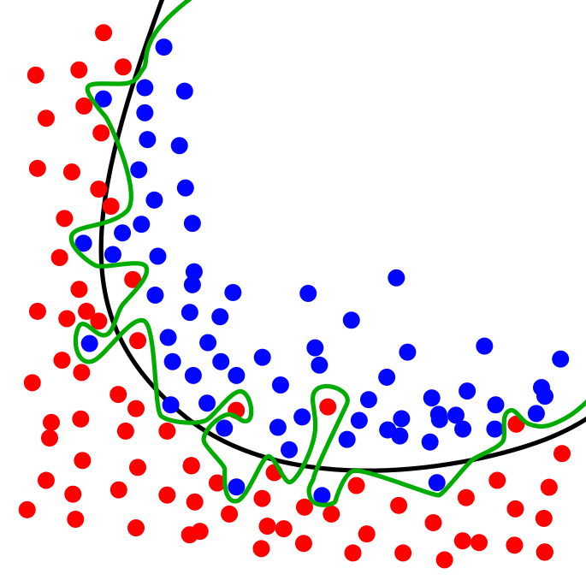
Overfitting
Corresponding too closely or exactly to the training data
Not generalizing → Poor performance when seeing new data / test data
[Wikipedia] Overfitting in regression
[Wikipedia] Overfitting in classification
Notes:
1, 3, 5 red
2, 4, 6 green

Slide 6
Underfitting
The learned model, being too simple/ too general
Not learning the details
Underfitting classifier
Overfitting classifier

Slide 7
Validation Set
A subset of training set
Avoid overfitting by choosing methods / models / parameters that perform best on validation set
Training Set
Test Set
Validation Set

Slide 8
Cross Validation
Choose different subsets of training set as validation sets, and train on remaining data
Avoid overfitting by choosing methods / models / parameters that on average perform best on various validation sets
Training set 1
Training set 2
Training set 3
Validation Set 2
Validation Set 3
Validation Set 1

Slide 9
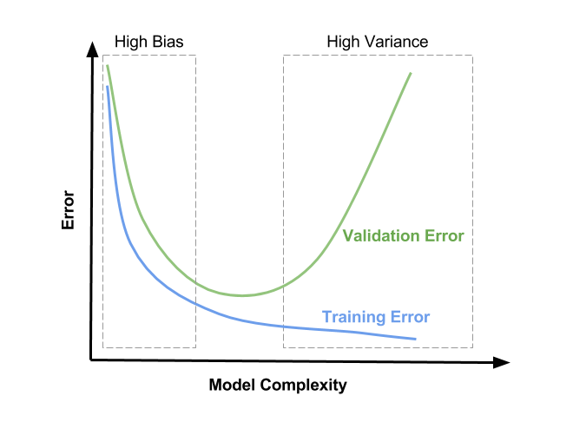
Validation Set
Optimize parameters based on data not used in training
Validation set
A randomly selected subset of the training set
To avoid under or overfitting when optimizing classifiers or regressors
Cross validation
Leave-1-out
Leave-p-out
Repeat and take average
https://learnopencv.com/bias-variance-tradeoff-in-machine-learning/

Slide 10
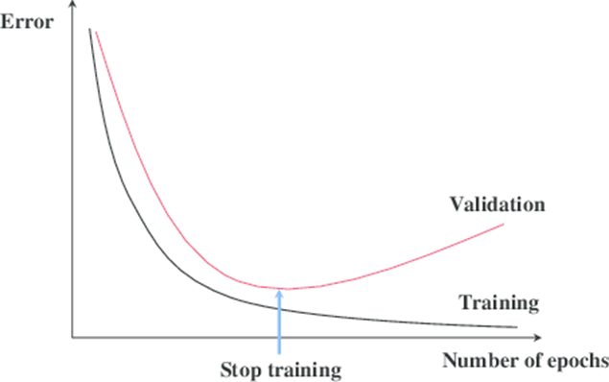
Validation Sets for Neural Network Training
Neural networks must be trained over many iterations (epochs). To ensure an optimum number of epochs, the performance error is measured on the training and validation sets.
[Ref: http://fouryears.eu/tags/theory/]

Slide 11
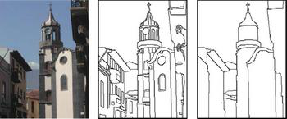
Ground Truth [3]
In simple words, ground truth is the perfect answer
Sometimes not possible to calculate/ measure
Often annotated/ provided / labelled by multiple human subjects (e.g. Amazon Mechanical Turk)
The more human subjects, the less it will be considered as ‘subjective’
Example:
Berkeley segmentation and boundary detection dataset
30 human subjects
https://www2.eecs.berkeley.edu/Research/Projects/CS/vision/bsds/

Slide 12
Performance Evaluation

Slide 13
How well is the algorithm working?
After implementing an algorithm, we want to know
How well it is working?
How does it compare with other algorithms
Qualitative Performance Evaluation
Show the performance of the algorithm (by examples)
Show cases where it works well (or better than competition)
Show cases where it fails
Quantitative Performance Evaluation
Not subjective, based on a test set and an evaluation measure
Fair to all methods being compared

Slide 14
Assessing Classification Models

Slide 15


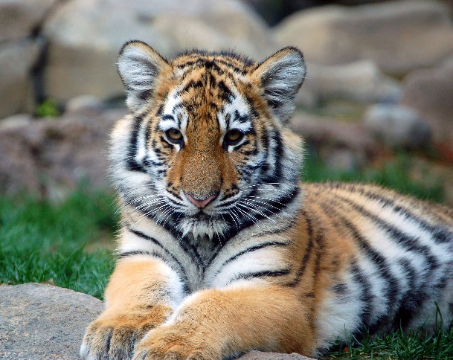
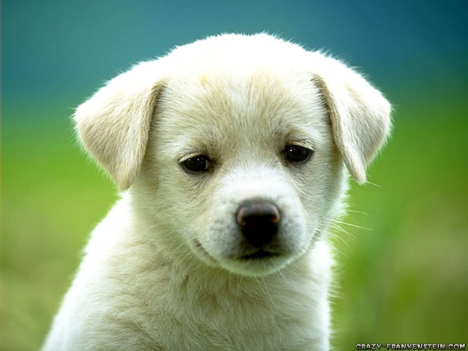
Example: (House) Cat-Finder!
Is there a cat in the image?
Correct Answer (ground truth):
Yes Yes No No
Algorithm’s output:
Yes No Yes No
TP FN FP TN

Slide 16
Metrics for Recognition/ Classification
TP (True Positives):
Number of samples identified correctly as belonging to a class / category
FP (False Positive): (False Alarms)
Number of samples identified incorrectly as belonging to a class / category
TN (True Negative):
Number of samples identified correctly as NOT belonging to a class / category
FN (False Negatives): (False Dismissal)
Number of samples identified incorrectly as NOT belonging to a class / category
Total number of samples = TP + FP + TN + FN

Slide 17
Binary Classification Accuracy Metrics
Percent Correct Classification (PCC)
PCC = (t_n + t_p)/(t_p + t_n + f_p + f_n)
For a highly- performing model, which cells should contain larger values?
Notes:
Typical confusion matrix with labels describing the quadrants of the confusion matrix.

Slide 18
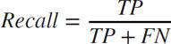
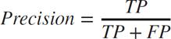
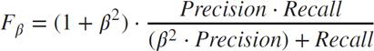
Precision / Recall
Recall: Percentage of objects successfully identified
Precision: Percentage of identified objects which are actually correct (not false alarms)
F- measure:
F₁ (β=1) is the most commonly used

Slide 19
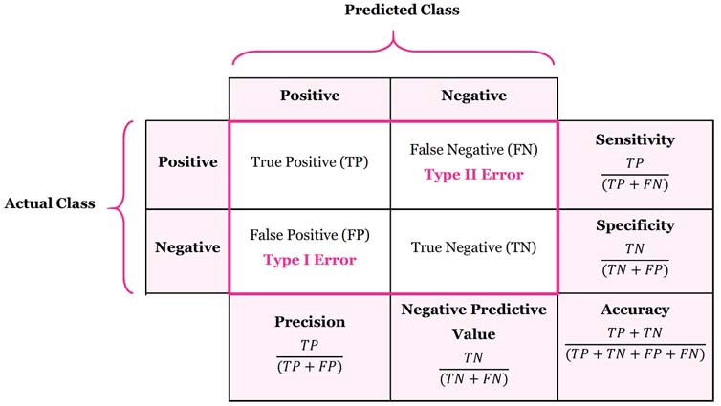
https://stats.stackexchange.com/questions/122225/what-is-the-best-way-to-remember-the-difference-between-sensitivity-specificity

Slide 20
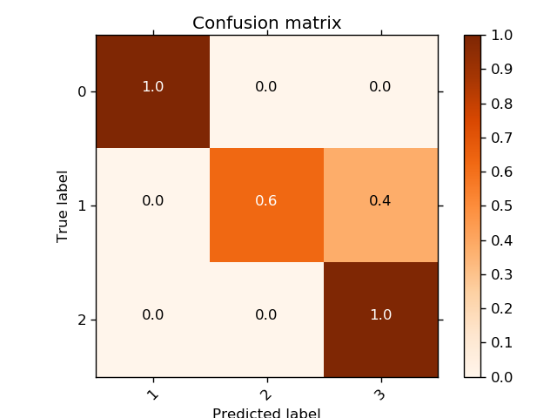
Confusion Matrix for Multi-Class Classification
Source: https://i.stack.imgur.com/9JbVM.png

Slide 21
Assessing Regression Models

Slide 22
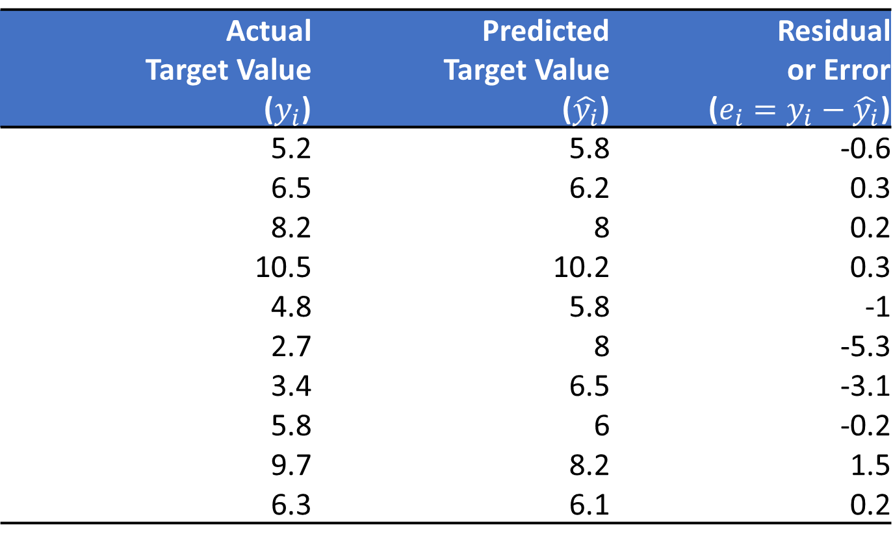
Residuals, Errors
Actual Target Value ($y_{i}$) | Predicted Target Value ($\hat{y_{i}}$) | Residual or Error ($e_{i}=y_{i}−\hat{y_{i}}$)
5.2 | 5.8 | -0.6
6.5 | 6.2 | 0.3
8.2 | 8 | 0.2
10.5 | 10.2 | 0.3
4.8 | 5.8 | -1
2.7 | 8 | -5.3
3.4 | 6.5 | -3.1
5.8 | 6 | -0.2
9.7 | 8.2 | 1.5
6.3 | 6.1 | 0.2

Slide 23
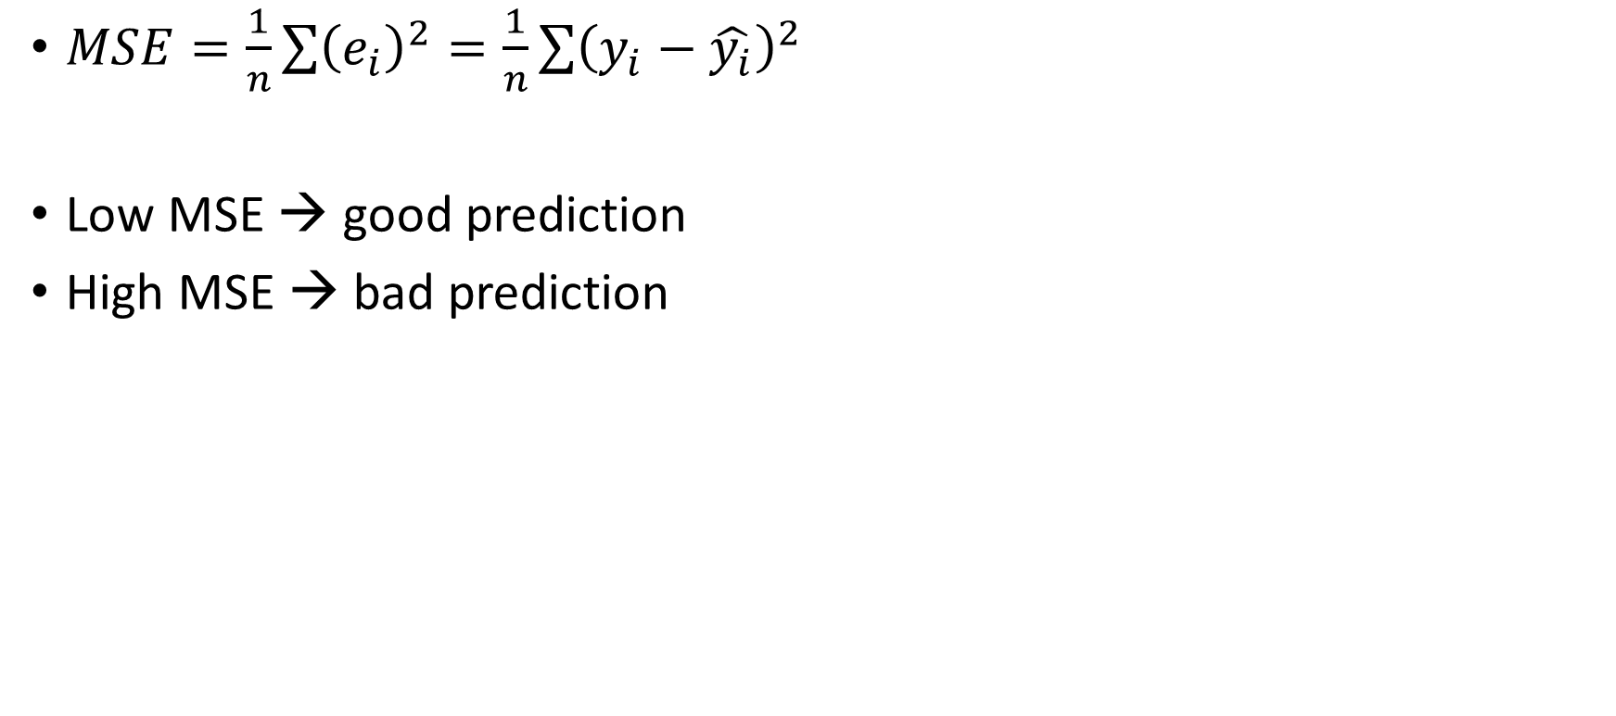
Mean Squared Error (MSE)
$MSE=\frac{1}{n}\sum{{\left(e_{i}\right)}^{2}}=\frac{1}{n}\sum{{\left(y_{i}−\hat{y_{i}}\right)}^{2}}$
Low MSE → good prediction
High MSE → bad prediction

Slide 24
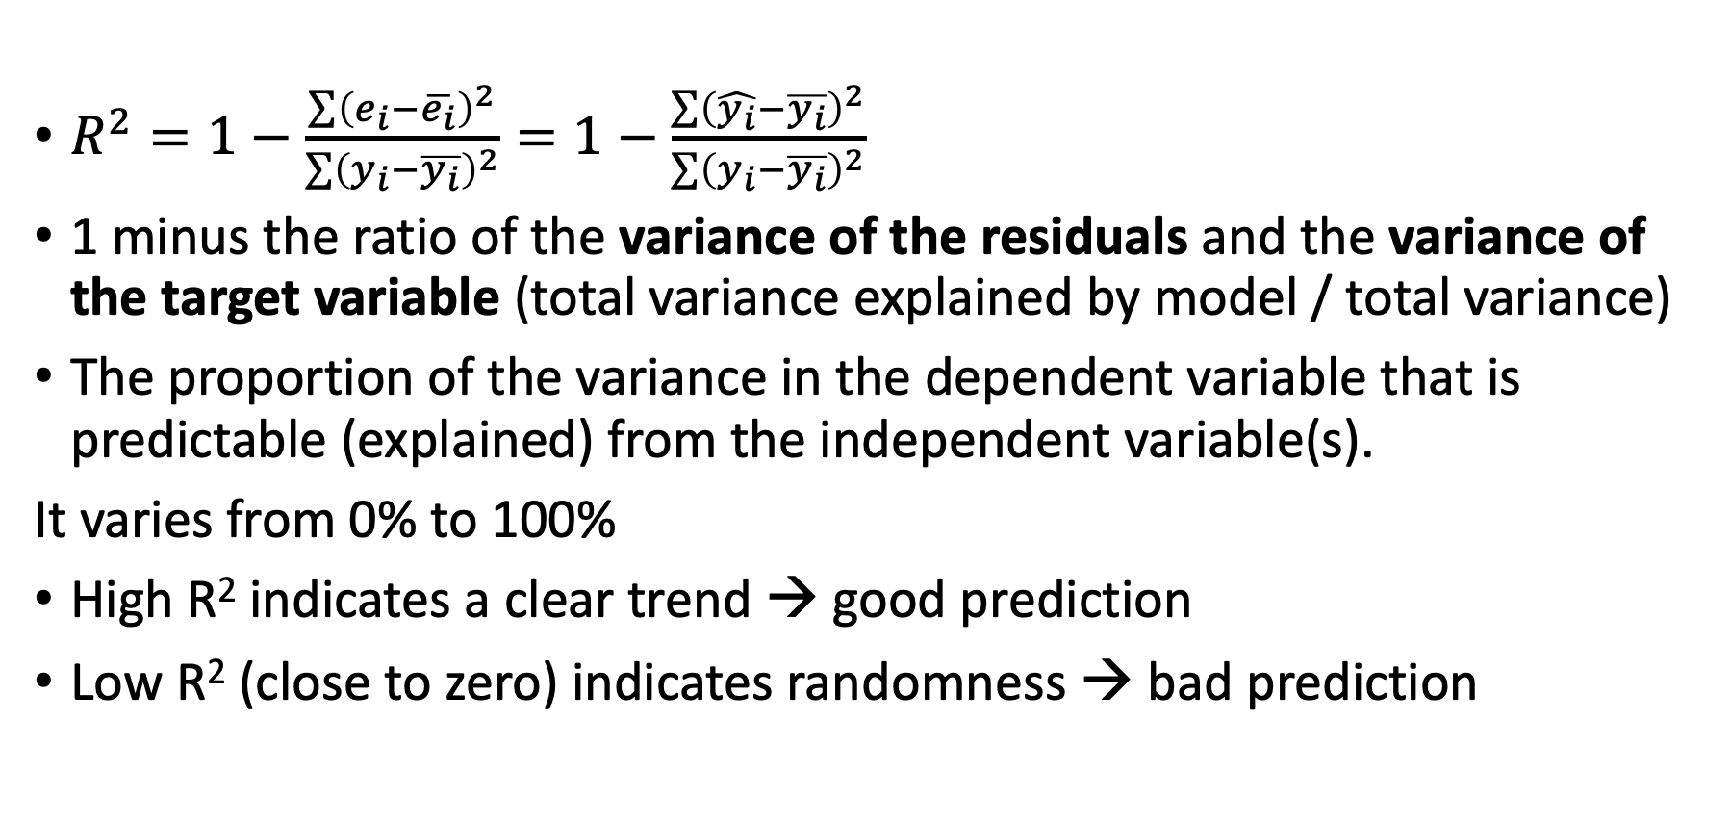
R-Squared Measure
$R^{2}=1−\frac{\sum{{\left(e_{i}−\overline{e_{i}}\right)}^{2}}}{\sum{{\left(y_{i}−\overline{y_{i}}\right)}^{2}}}=1−\frac{\sum{{\left(\hat{y_{i}}−\overline{y_{i}}\right)}^{2}}}{\sum{{\left(y_{i}−\overline{y_{i}}\right)}^{2}}}$
1 minus the ratio of the variance of the residuals and the variance of the target variable (total variance explained by model / total variance)
The proportion of the variance in the dependent variable that is predictable (explained) from the independent variable(s).
It varies from 0% to 100%
High R² indicates a clear trend → good prediction
Low R² (close to zero) indicates randomness → bad prediction

Slide 25
Assessing ROI-Based Methods

Slide 26
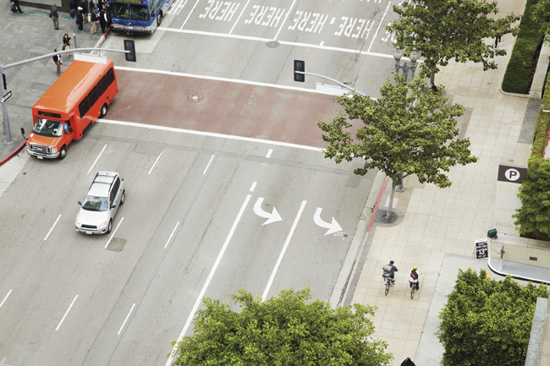


Region of Interest (ROI)
A region in the image, often specified by a rectangle
Object Detection
Face Detection & Recognition
Optical Character Recognition
bus
bus
Cyclist
car
Cyclist
The Toronto Dominion Bank

Slide 27
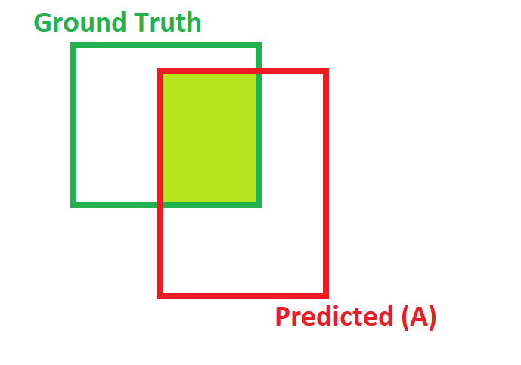
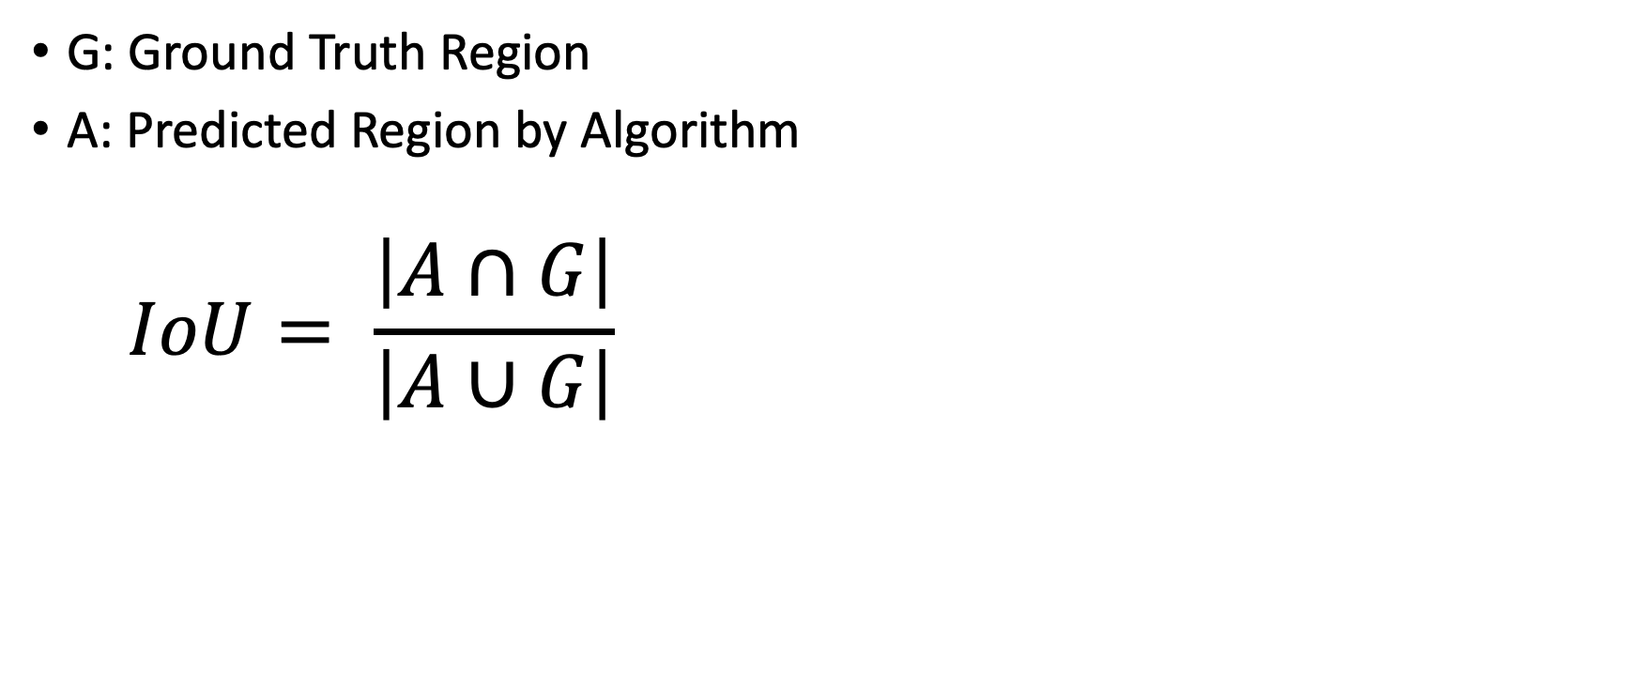
Intersection-over-Union (IoU)
G: Ground Truth Region
A: Predicted Region by Algorithm
$$IoU= \frac{\left|A∩G\right|}{\left|A∪G\right|}$$

Slide 28
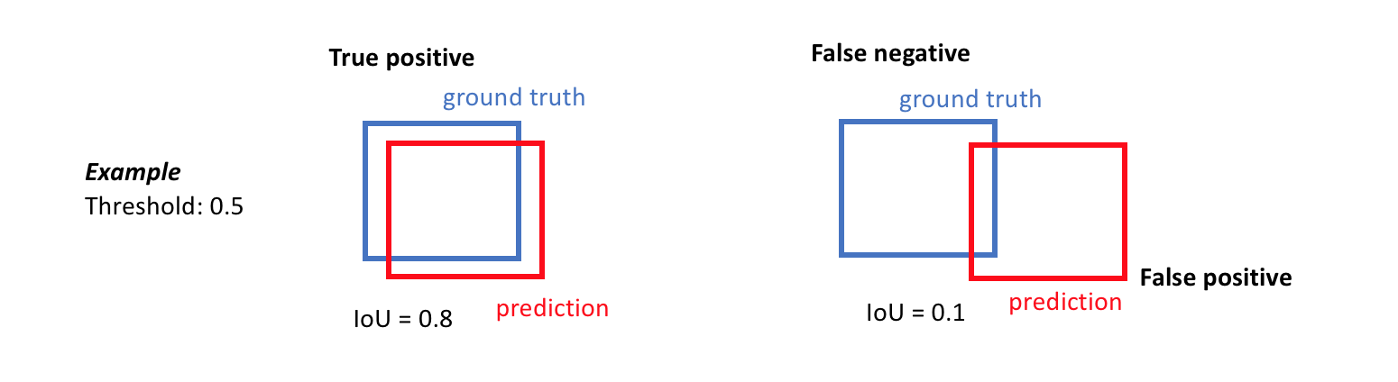
From IoU to Precision & Recall
By choosing a threshold, IoU can be translated to a hit (True Positive) or miss (False Positive)
https://www.jeremyjordan.me/evaluating-image-segmentation-models/

Slide 29
Precision / Recall
Recall: Percentage of objects successfully identified
Precision: Percentage of identified objects which are actually correct (not false alarms)

Slide 30
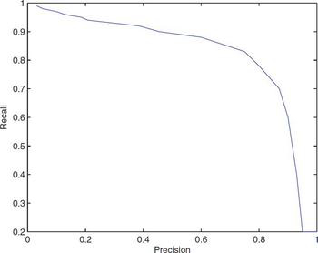
Precision-Recall (PR) Curves
Low threshold (close to 0) – high recall, low precision
High threshold (close to 1) – low recall, high precision
A common performance measure: Area under the PR curve (or ROC curve)

Slide 31
Summary
In order to obtain models that perform well on future samples, datasets are often split into training, test and validation sets. Only the training dataset is used for training models.
In addition to evaluating the performance of an algorithm qualitatively and subjectively (by looking at sample output), it is better to use quantitative and objective performance measures.
There are general performance measures for classification and regression. Vision-based measures (e.g. ROI-based IoU) are also used.

Slide 32
References
[1] Computer Vision: Algorithms and Applications, R. Szeliski (http://szeliski.org/Book)
[2] Learning OpenCV 3, A. Kaehler & G. Bradski
Available online through Safari Books, Seneca libraries
https://senecacollege-primo.hosted.exlibrisgroup.com/primo-explore/fulldisplay?docid=01SENC_ALMA5153244920003226&context=L&vid=01SENC&search_scope=default_scope&tab=default_tab&lang=en_US
[3] Practical introduction to Computer Vision with OpenCV, Kenneth Dawson-Howe
Available through Seneca libraries
https://senecacollege-primo.hosted.exlibrisgroup.com/primo-explore/fulldisplay?docid=01SENC_ALMA5142810950003226&context=L&vid=01SENC&search_scope=default_scope&tab=default_tab&lang=en_US
[4] Applied Predictive Analytics: Principles and Techniques for the Professional Data Analys, Dean Abbott

Slide 33
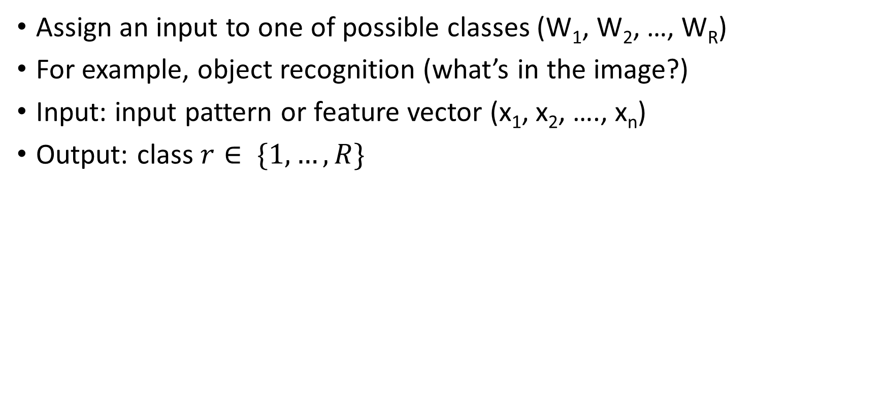
Classifier
Assign an input to one of possible classes (W₁, W₂, …, W_{R})
For example, object recognition (what’s in the image?)
Input: input pattern or feature vector (x₁, x₂, …., x_{n})
Output: class $r∈ \{1,…, R\}$
x₁
x₂
x_{n}
Classifier
.
.
.
r

